Slide 1
QA Core Project
Daniel Maton-Walker

Slide 2
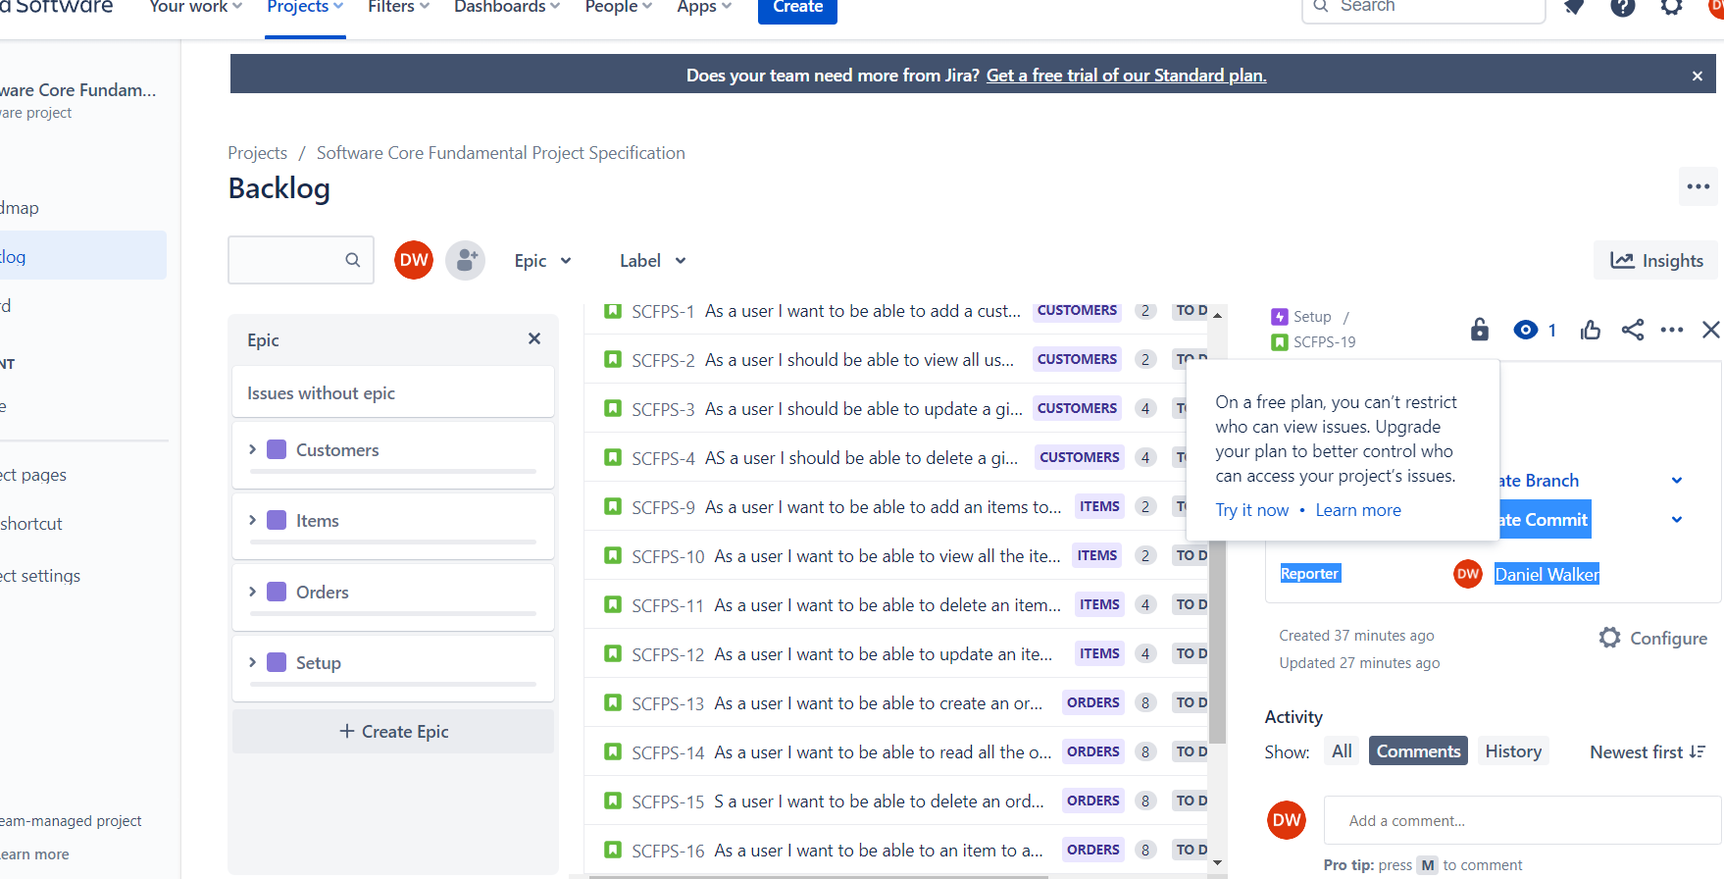
Jira Backlog

Slide 3
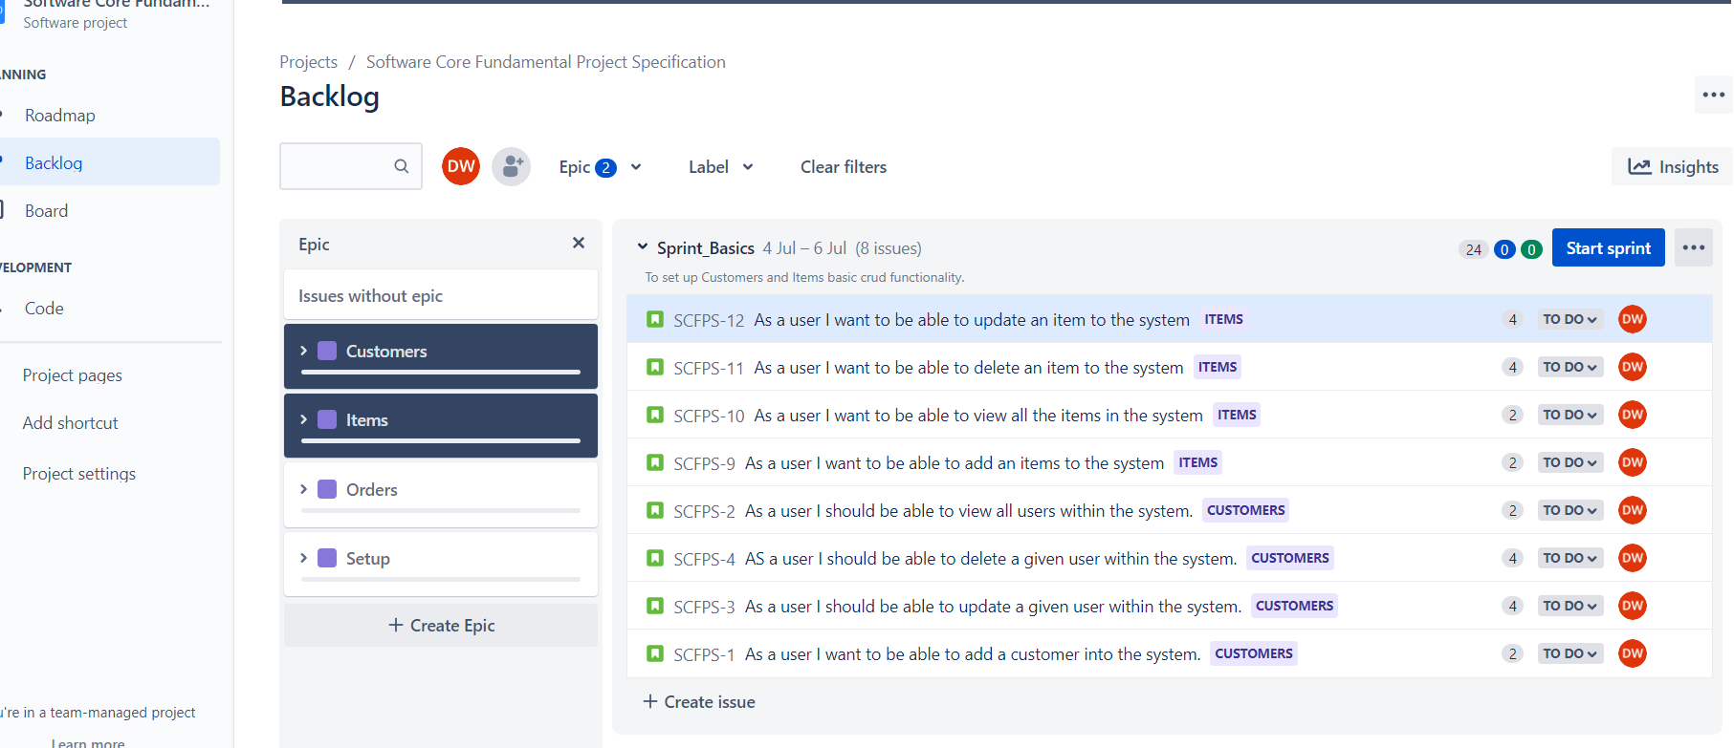
Sprint1

Slide 4
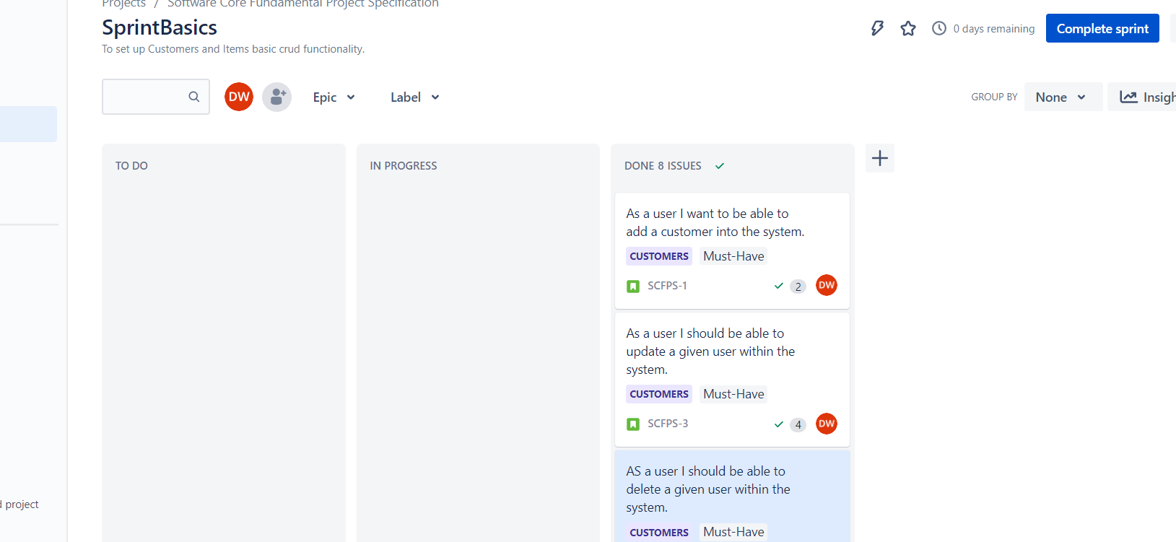
Sprint 1- Customers & Items

Slide 5
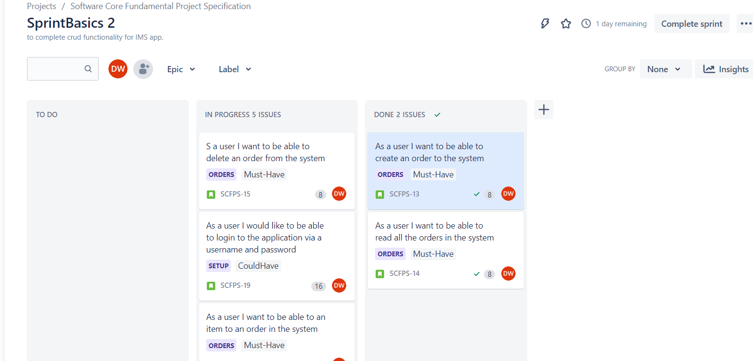
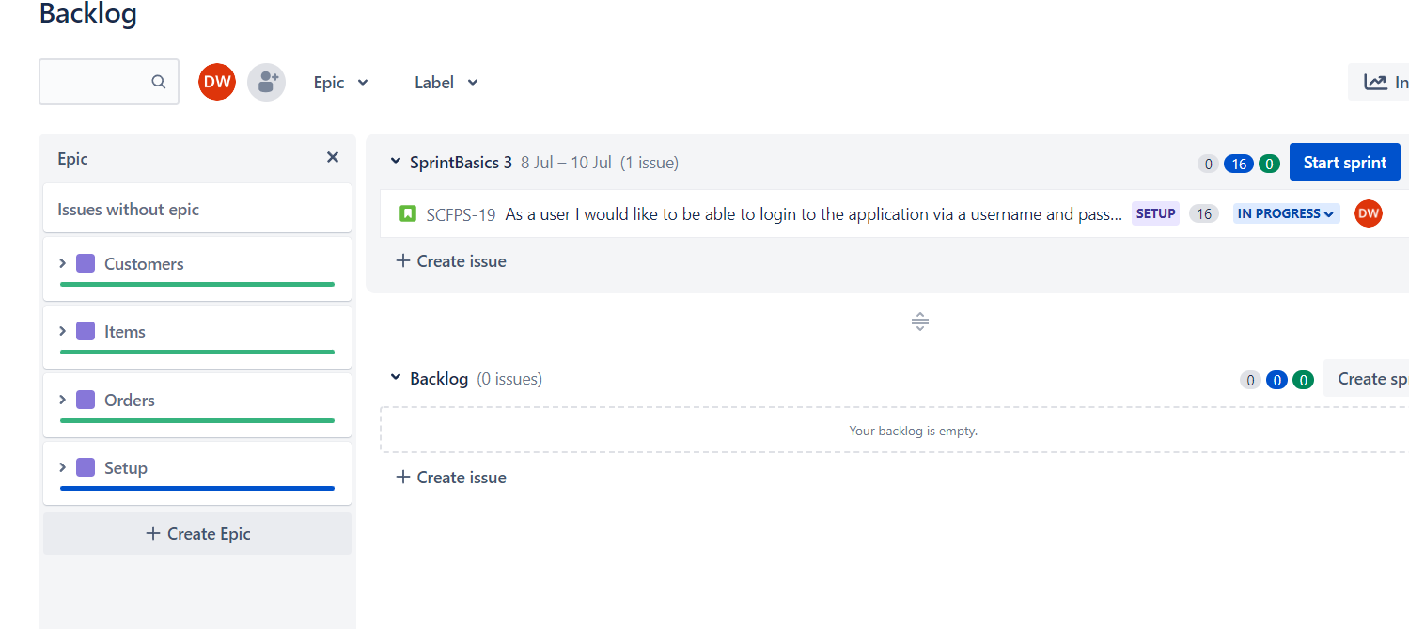
Sprint2 Orders

Slide 6
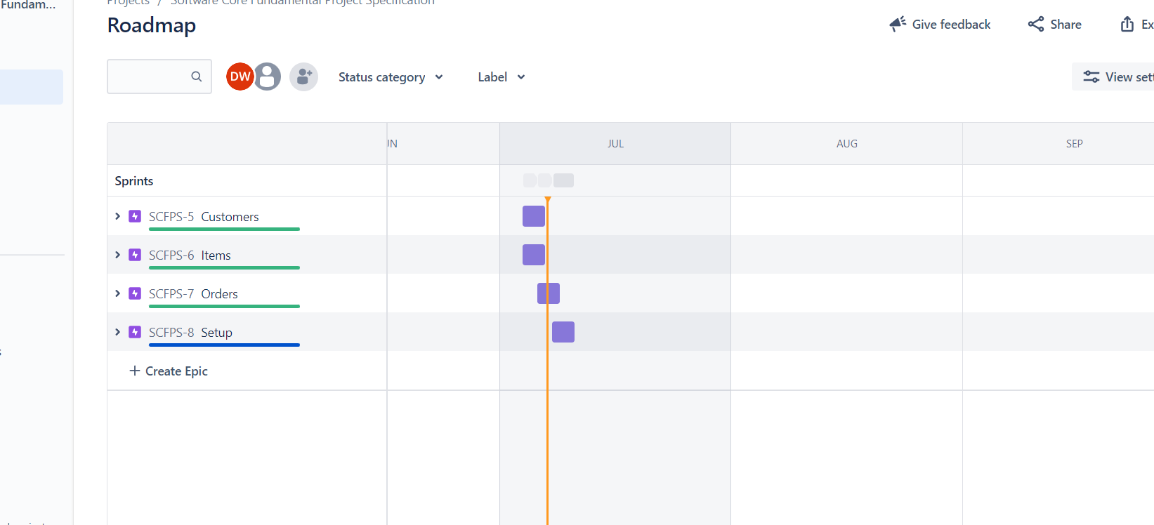
Completed Roadmap

Slide 7
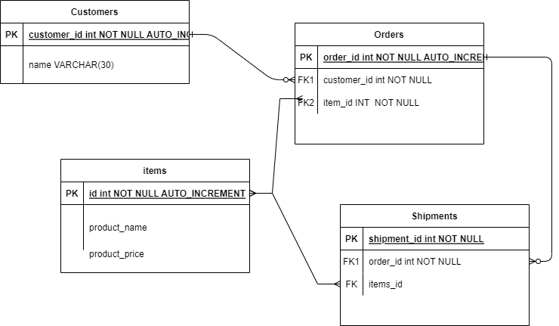
UML-1

Slide 8
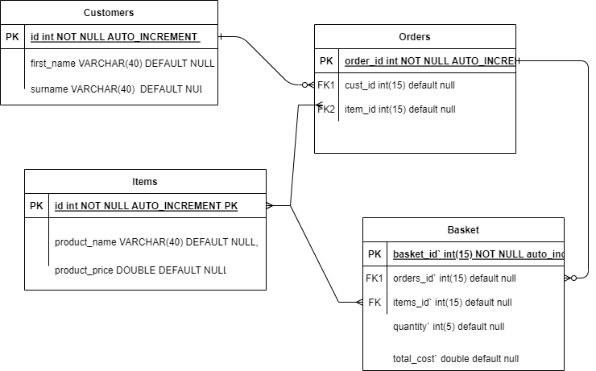
Final Database UML

Slide 9
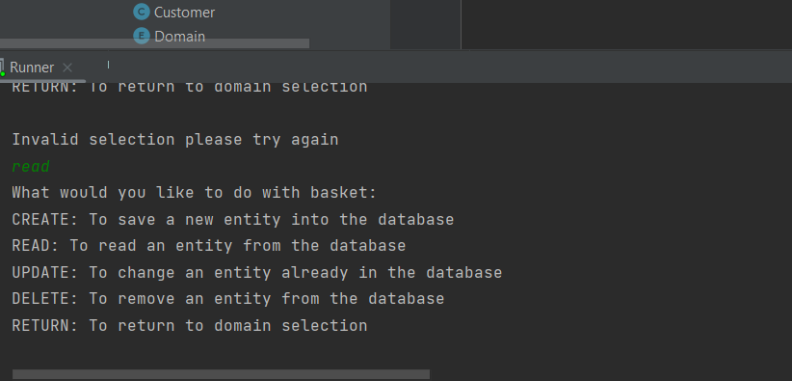
Command line demo

Slide 10
What went well!
It was a good project to explore java
All Crud functions are working
MVP product was met

Slide 11
What didn’t go well!
I had some issues adding and removing items for an order so had to change my database setup to achieve the task.
For my next project I will prepare more on how to implement simple but effective solutions and not get bogged down with trying fancier solutions

Slide 12
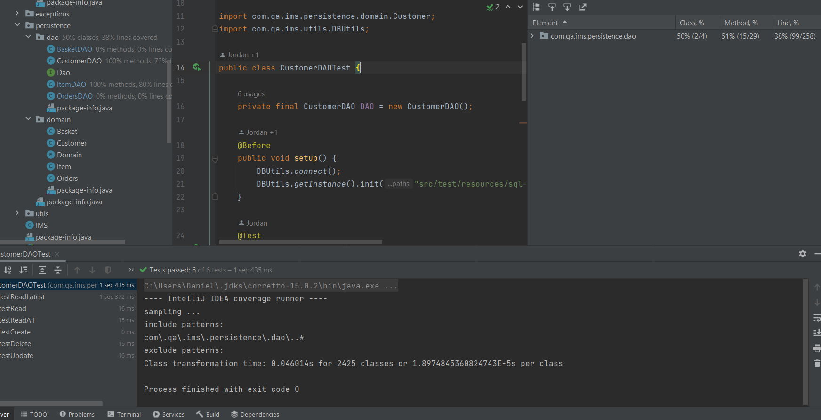
Testing Coverage customer

Slide 13
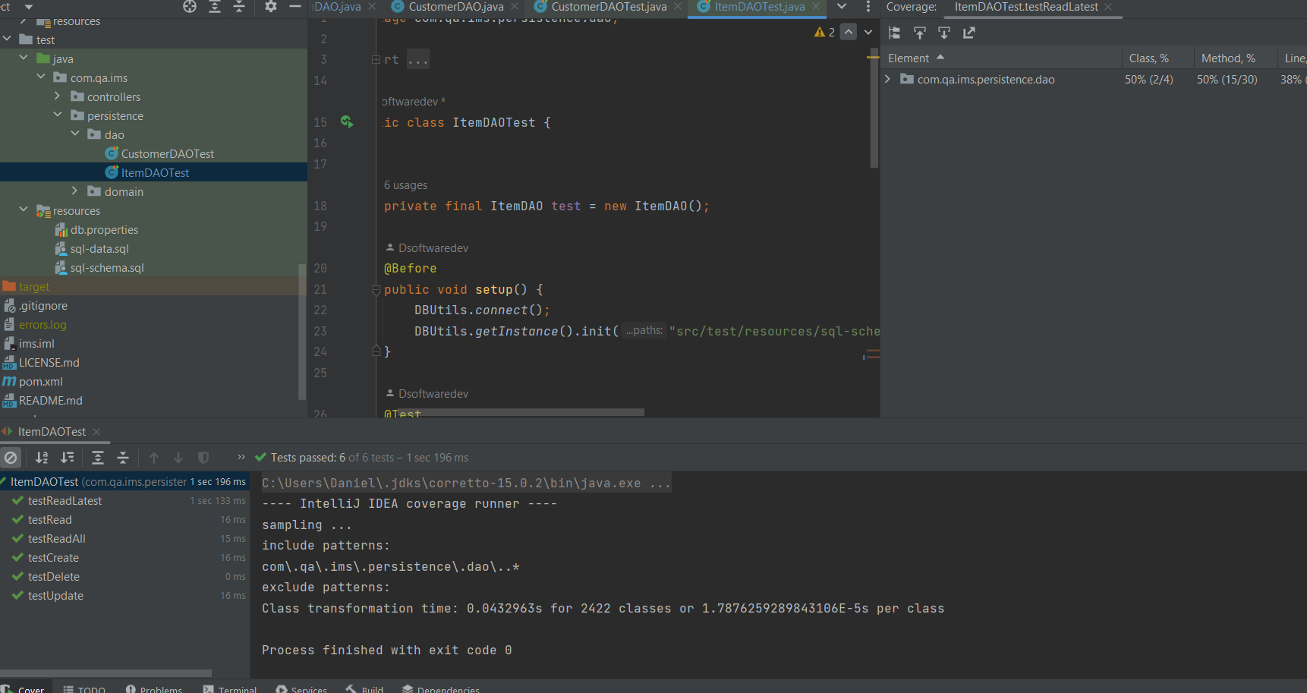
Test Coverage Item

